Slide 1
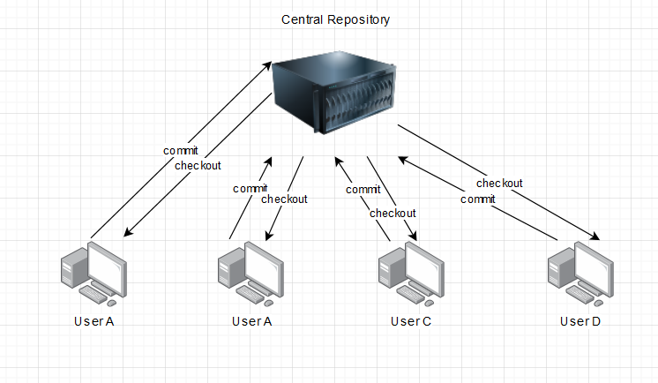
Centralized Version Control System

Slide 2
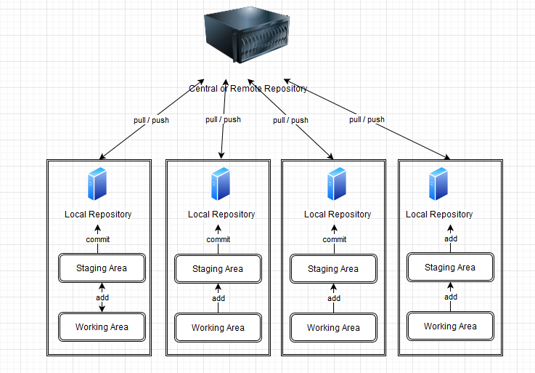
Decentralized Version Control System

Slide 3
SVN | Git
Single Repository | Multiple Repository
The whole story in one place | The whole story distributed in multiple repositories
svn checkout keeps a copy of last revision from remote repo | git clone keeps a copy of entire remote repo
svn commit sends changes to remote repository revision number is incremented | git commit only commits to local repository revision number is a hash value git push command is required to push code to remote repo
svn diff must be online | git diff can be offline

